Slide 1

Mobile Application

Slide 2
Audit Module

Slide 3
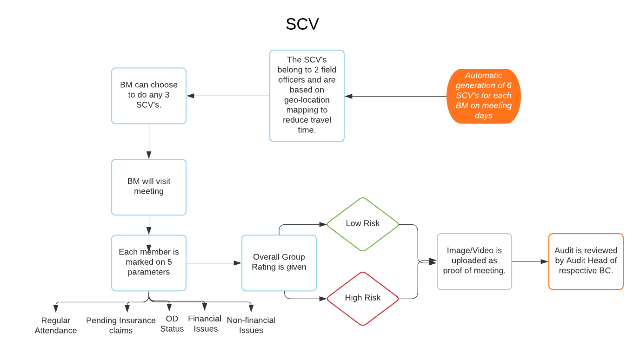
SCV- Process Flow
Audit Manager will review the audit
Audit Manager will check if deviations are closed

Slide 4
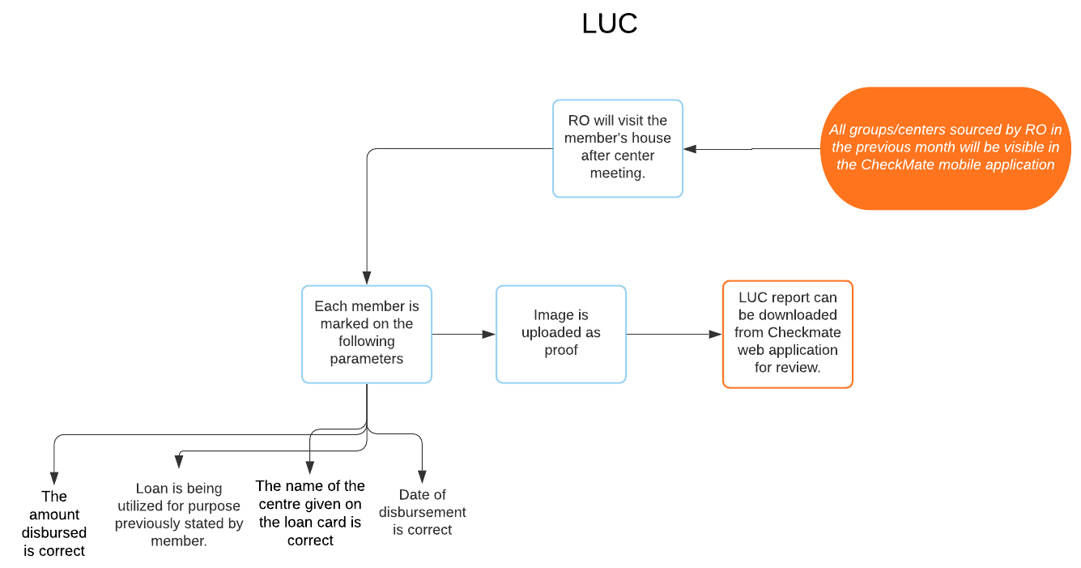
LUC- Process Flow
If loan purpose matches loan utilization
Image/ proof of
utilization

Slide 5
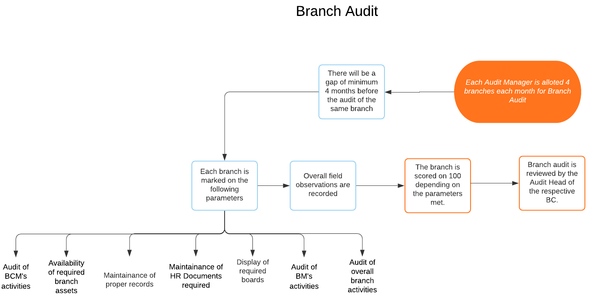
Branch Audit- Process Flow

Slide 6
Log-in Functionality

Slide 7

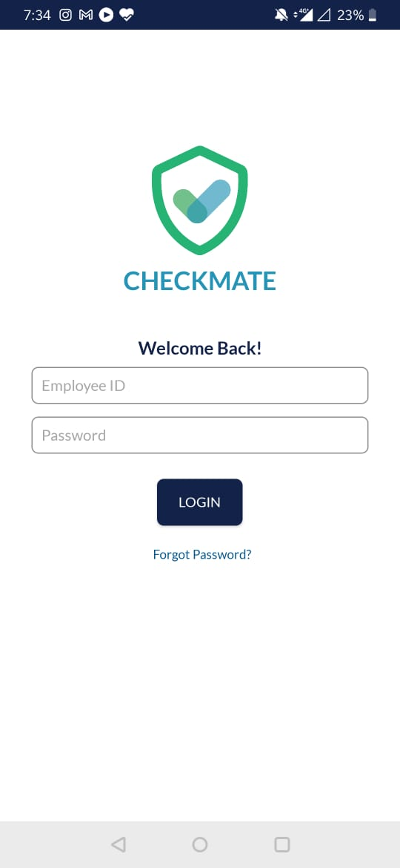
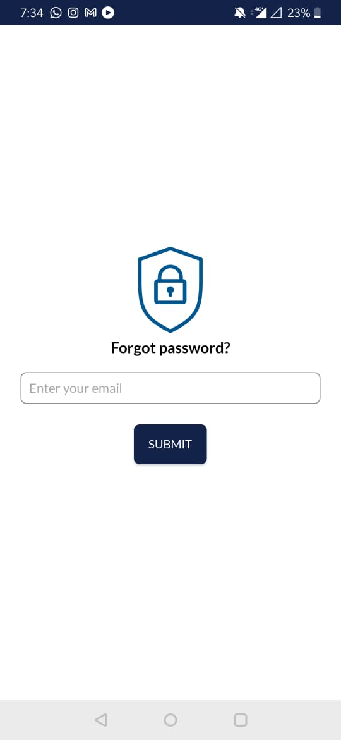
Log in screens
Loading Screen
Login Screen
Forgot Password

Slide 8
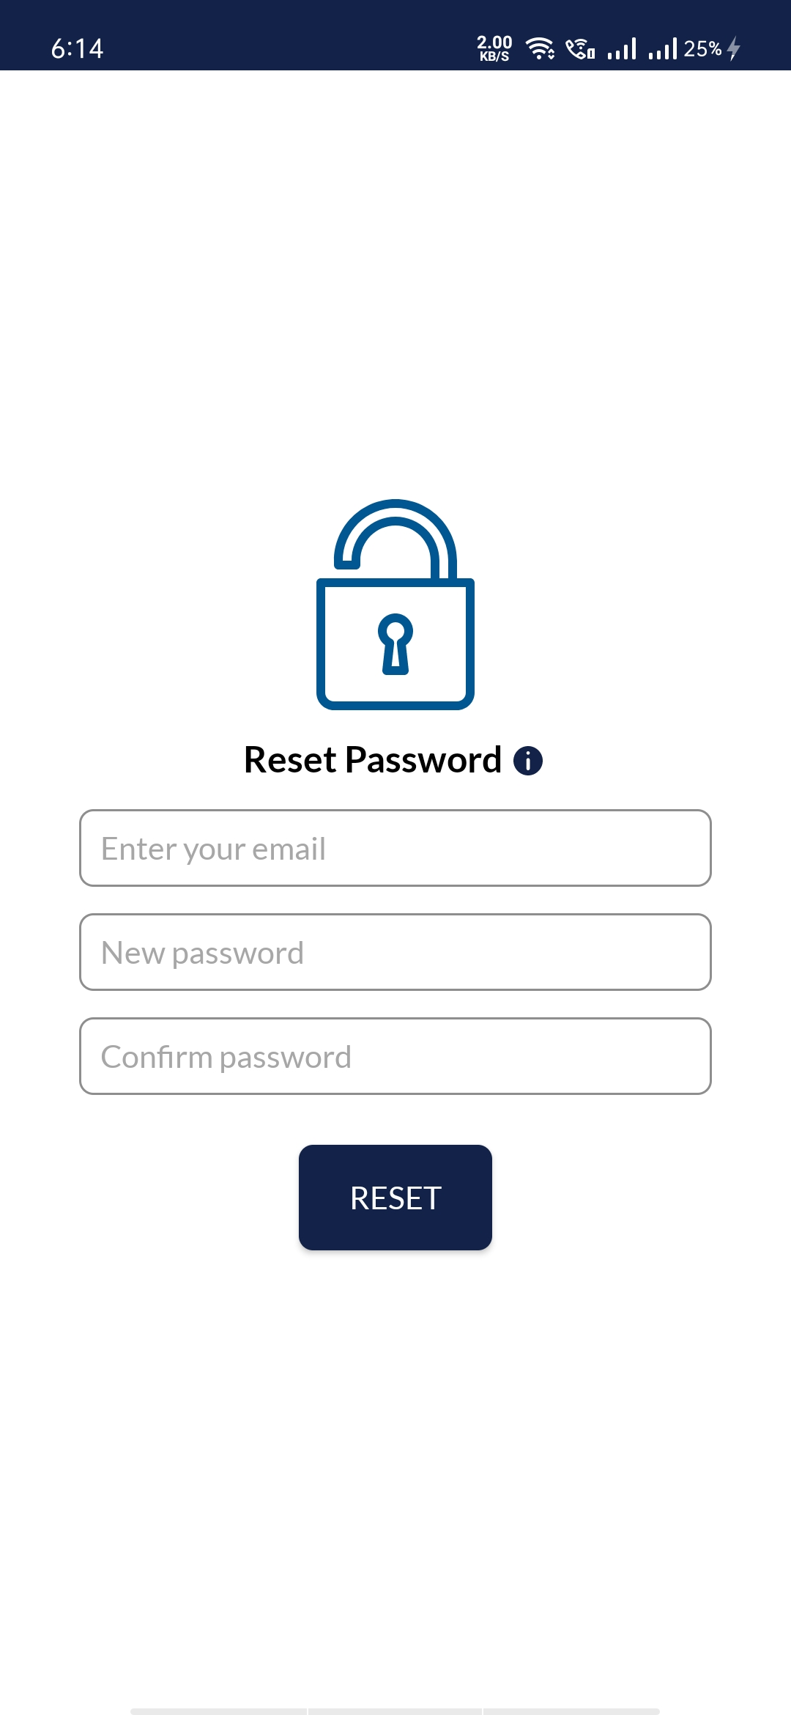
Reset Password Screens

Slide 9
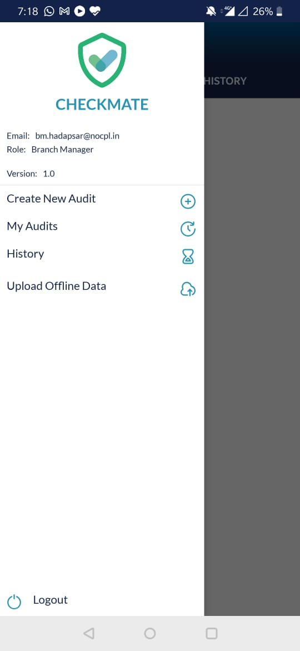
Navigation Slider
Navigation Slider

Slide 10
Mobile Application
Role: Auditor

Slide 11
Create Audit Automation Rules
Role | Audit Type | Reviwer | Automation Rules
RO | LUC | NA | All groups sourced the previous month will have to be audited. For e.g.- all groups sourced from 1st-31st March will be audited between 1st-30th April
BM | SCV | NA | 6 audits (of 6 groups) to be assigned for groups belonging to 2 Ros (2 from 1RO, 1 from 2nd) 8-9:30 9:30-10:30 11:00-12:00 Time will change every month 15 meeting days. Same group will not get repeated. Any Sunday- postpone/ prepone Pop up- do 3 SCV’s in a day. If 3 SCV’s have not been submitted that day- notification at 5pm: why were you unable to do 3 SCV’s today?
Audit Manager | Branch Audit | SCV | 4 branches to be audited in a month. 3 month gap If all 8 audits are done in 2 months, branches with lowest score to be repeated in the 3rd month.
Audit Head | NA | SCV
 |  | Branch Audit

Slide 12
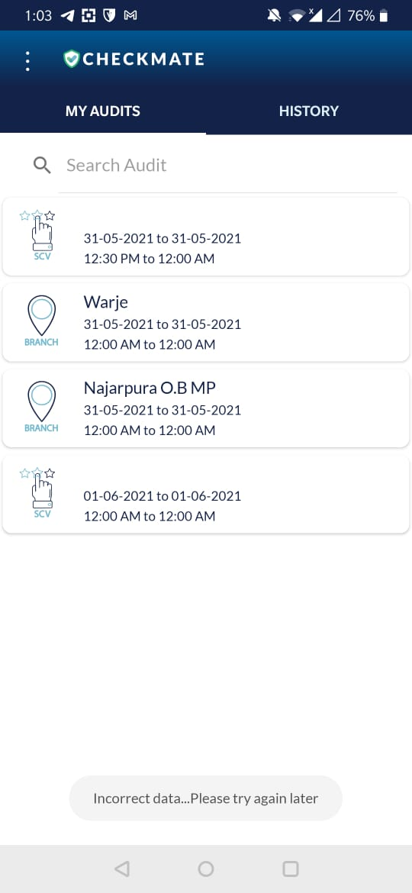
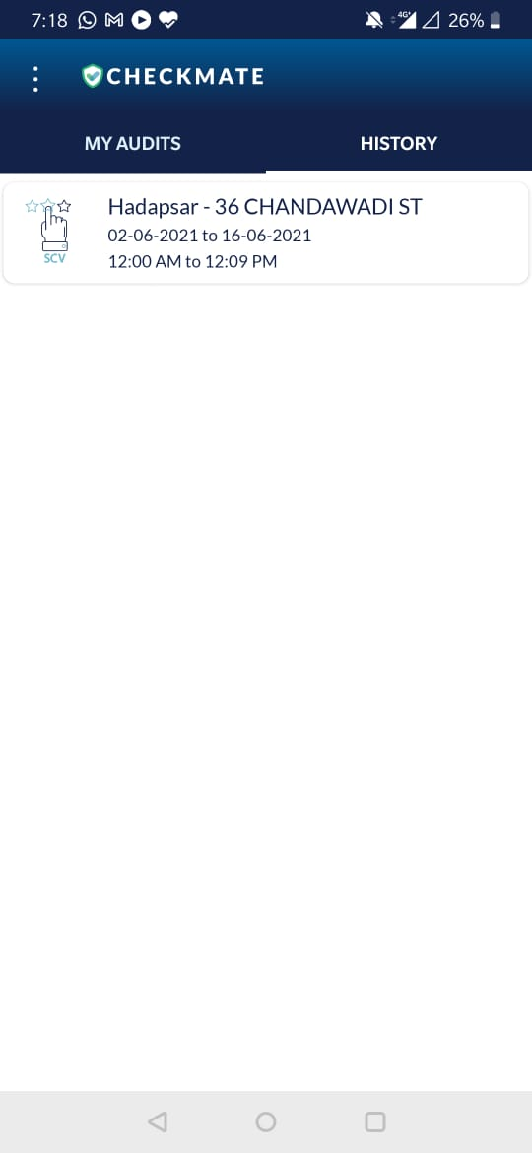
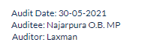

Role Wise Home Page
RO
BM
Audit Manager
Review
Review
Review

Slide 13
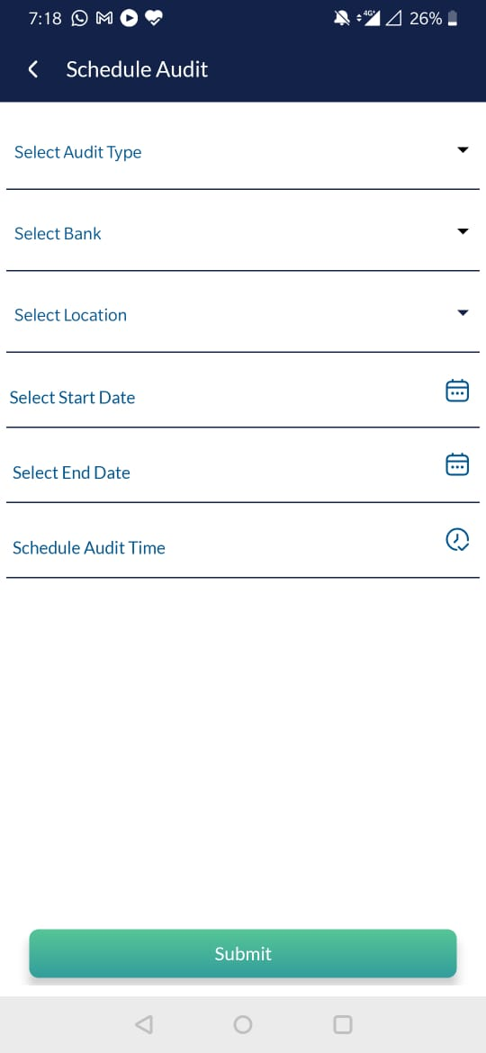
Schedule an Audit
Select Audit Type: Audit Type drop down should be according to role.
SCV Audit | BM
LUC Audit | RO
Branch Audit | Audit Manager
Bank/FI Name- to be automatically mapped to the role.
DCB
IDBI
RBL
USFB
YBL
KOTAK
AXIS
ESFB
FSFB
FEDFINA
NOTHERNARC
Date dropdown
Select Location:
In case of SCV Audit: Group names to drop down
In case of Branch Audit: branch names to drop down depending on district selected
In case of LUC Audit: Group Names to dop down
Audit should reflect in home page

Slide 14
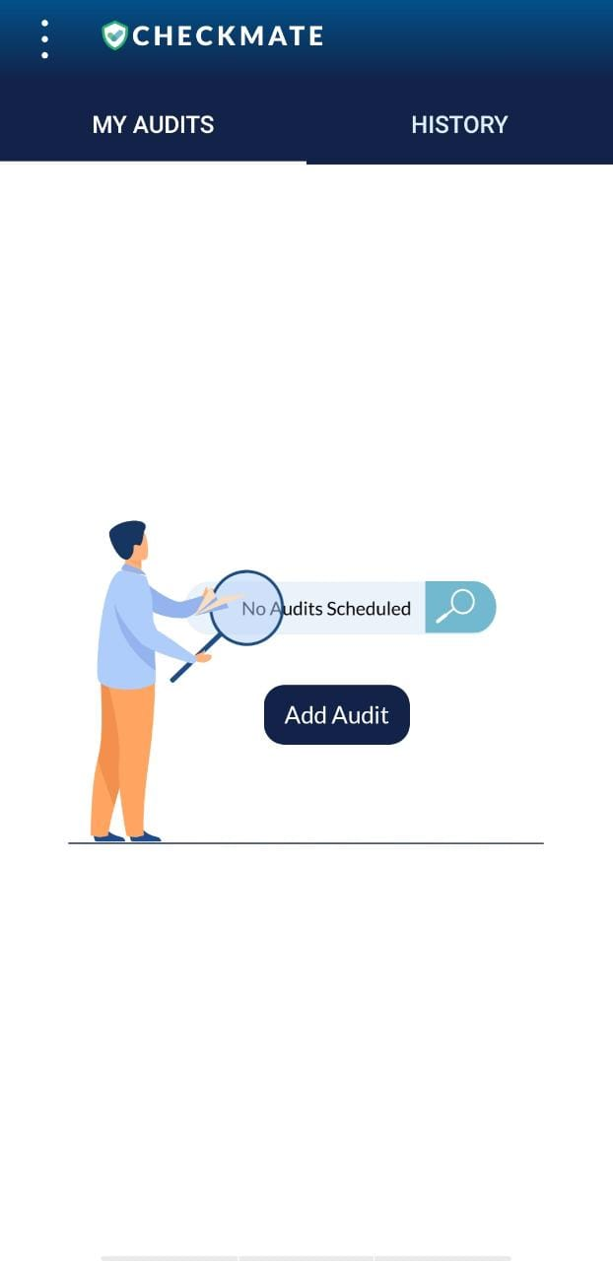
Home Page
Upcoming Audit (No Audit)
Upcoming Audit
Upcoming Audit (audit selected)
Auditee
Audit type

Slide 15
SCV Audit Flow

Slide 16
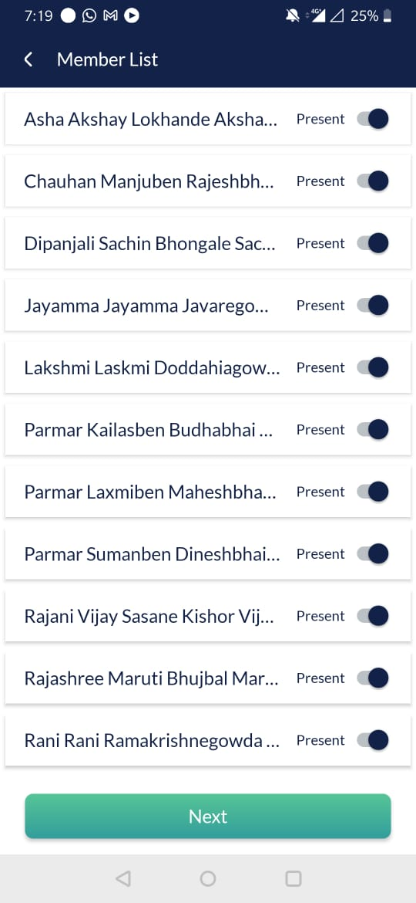
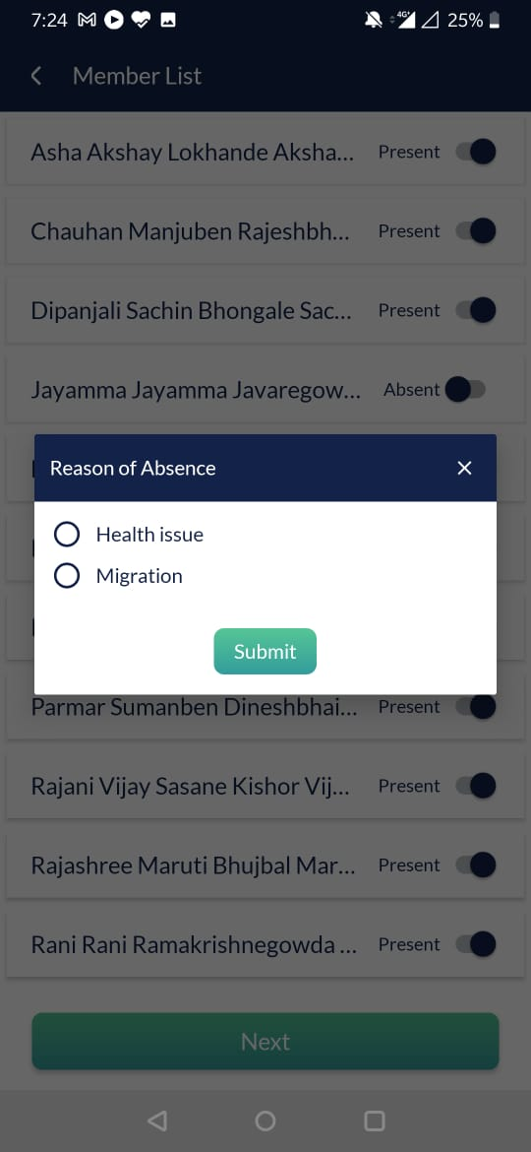
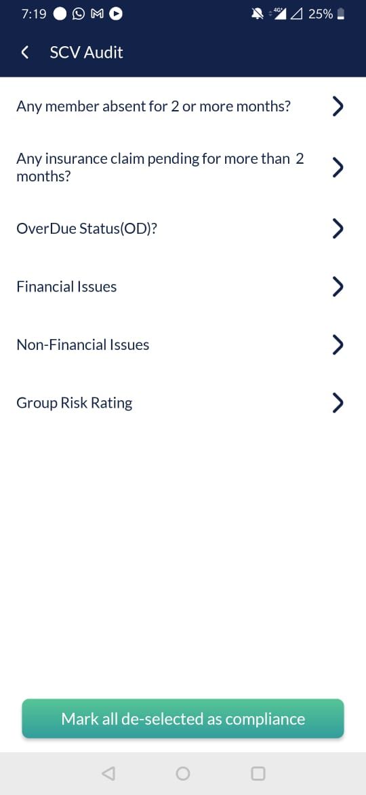
Start Audit- SCV
Absent members are marked.
On clicking absent (or tick), reason for absence pop up will be shown.
Next is then pressed to go to Audit screen.
Reason for absence can be:
Health Issue
Migration
-Absent without informing
6 points of audit will appear (all arrows when clicked will swipe to show all members.
After evaluating members on all parameters, ‘mark all de-selected as compliance’ will be clicked.

Slide 17
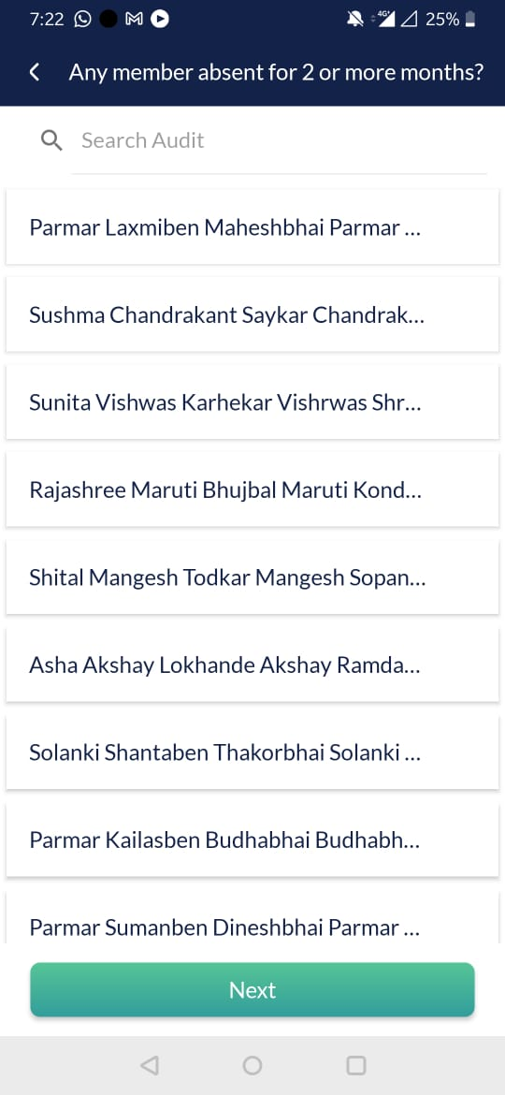
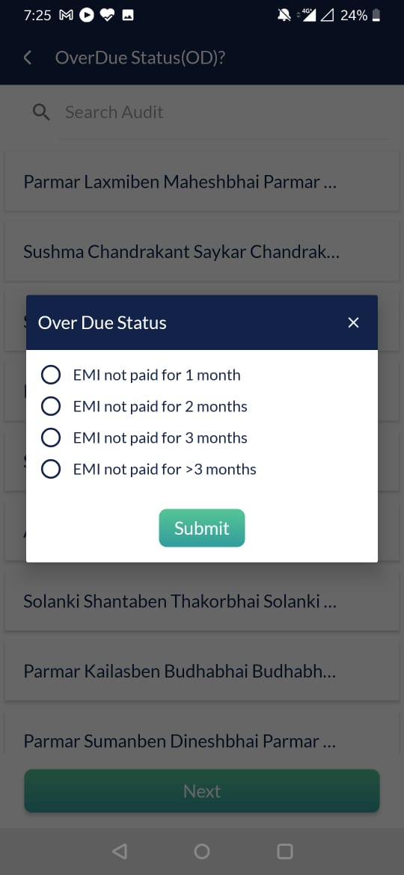
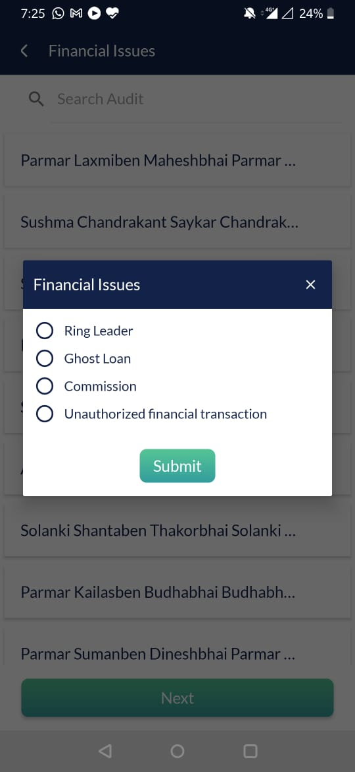
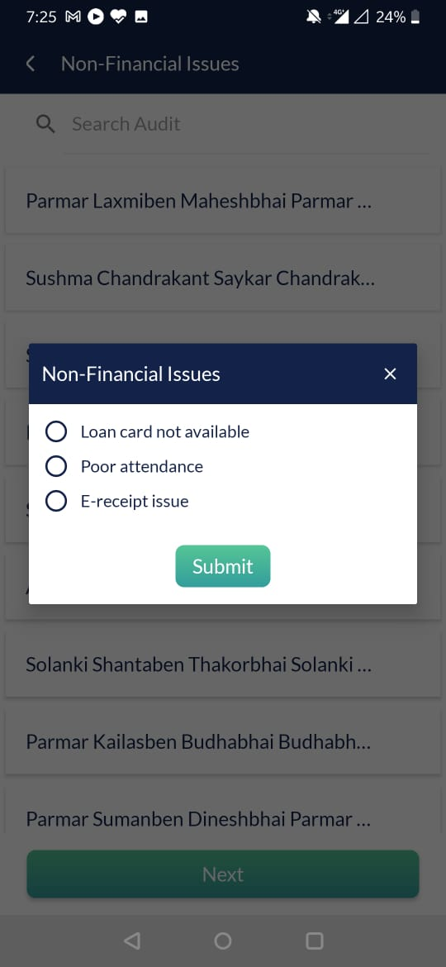
Start Audit- SCV
Member Name to be selected if the member fits the audit condition specified.
+ add OD amount of each member
Specific details will be highlighted under
Each audit point.

Slide 18
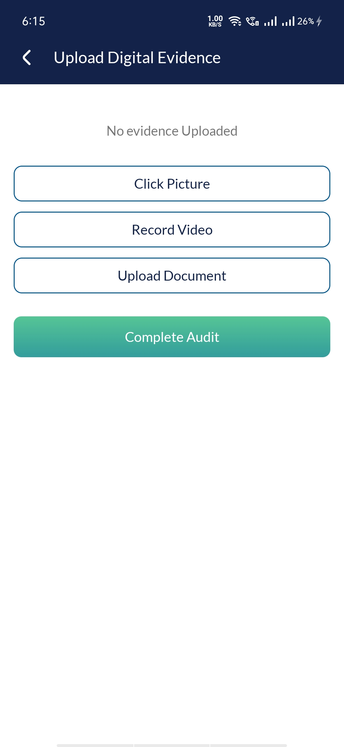
SCV- Submit Audit
Submit screen will open, where digital evidence must be recorded
(mandatory field, multiple files can be uploaded (photo, video, audio, doc-total max limit 25mb).
Then ‘complete audit’ will be clicked.
Submit will take you back to upcoming audit page.

Slide 19
LUC Audit Flow

Slide 20
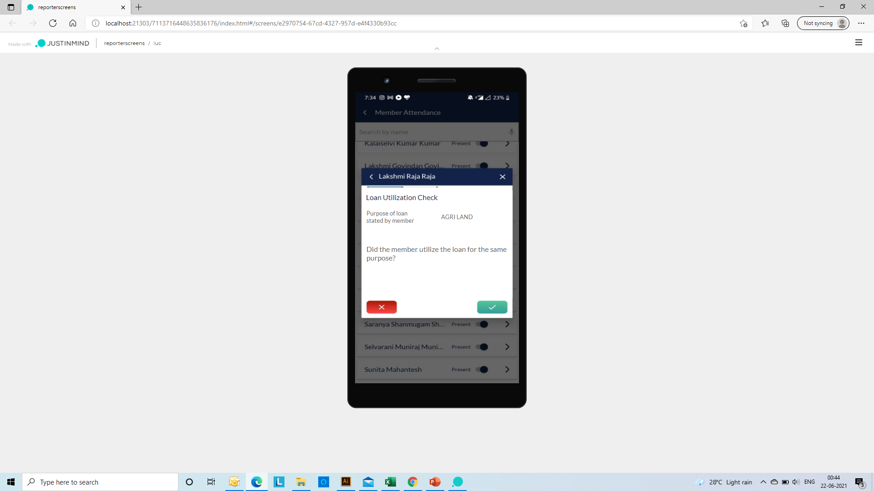
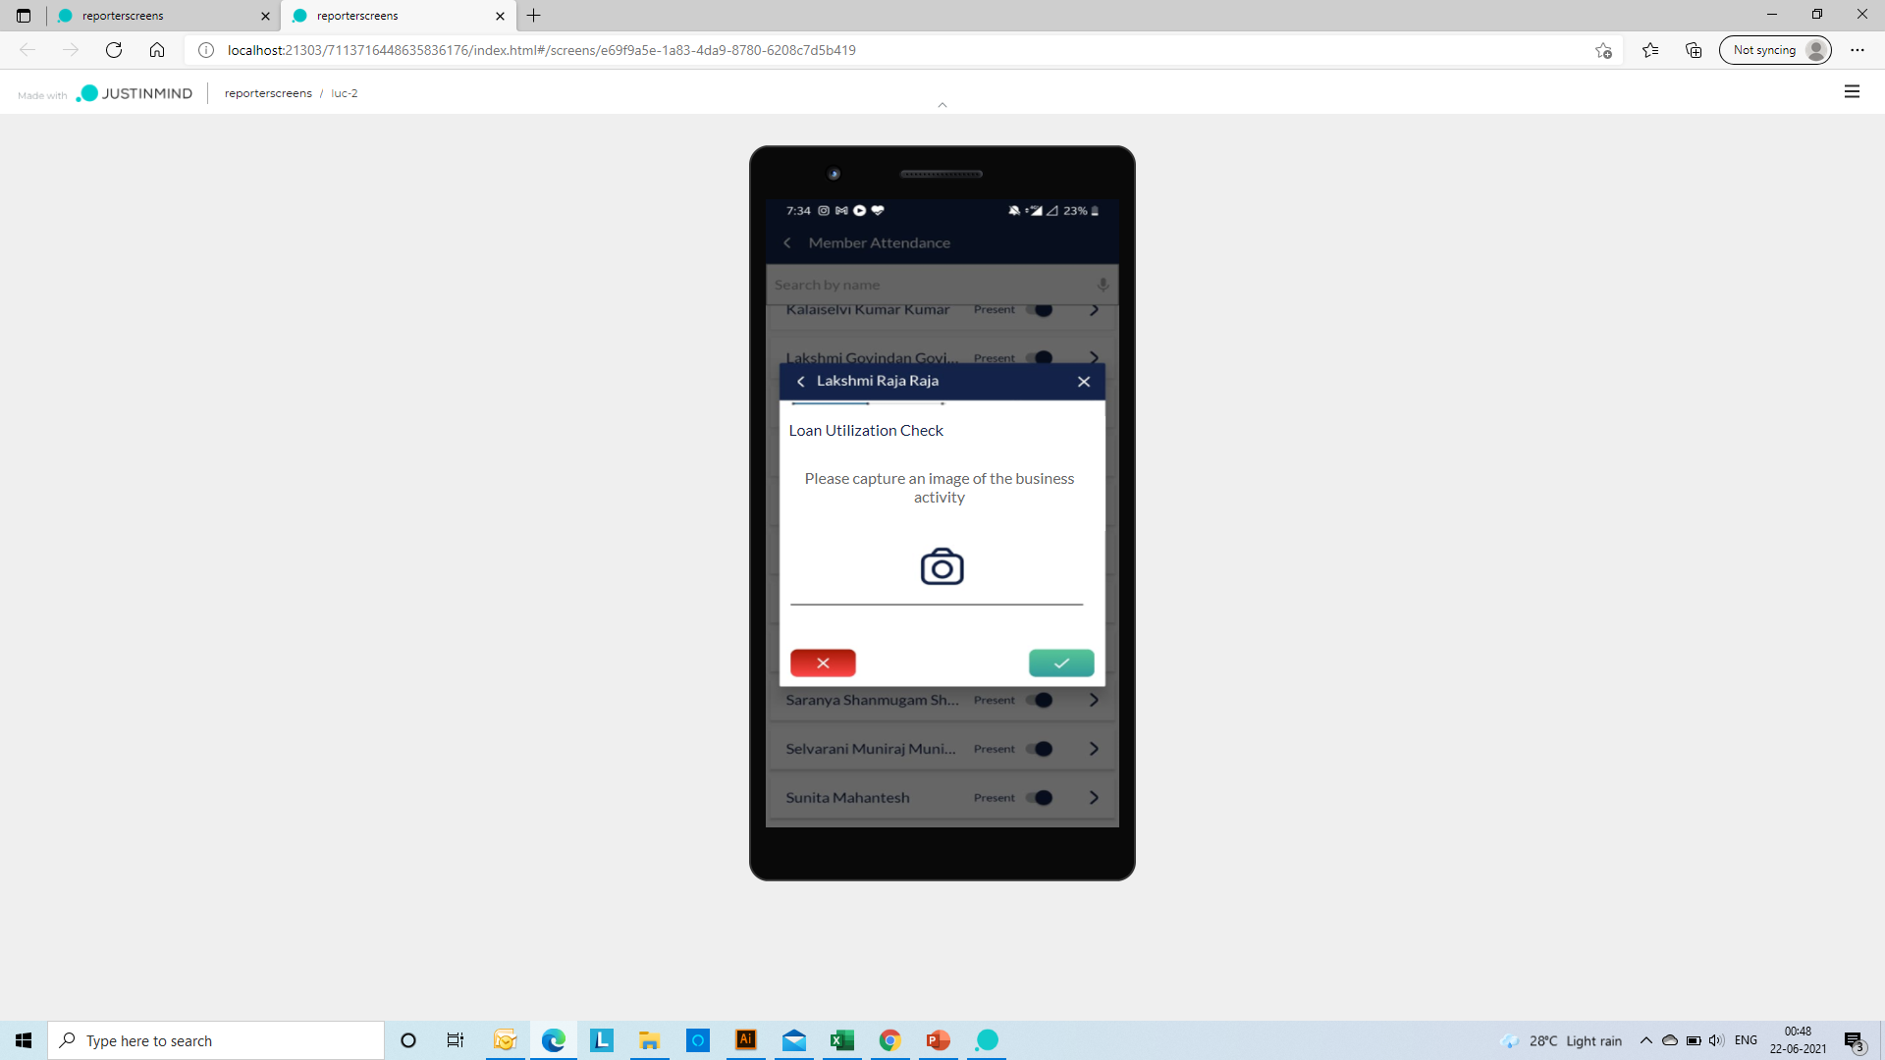
LUC Audit
Absent members are marked.
On clicking absent (or tick), reason for absence pop up will be shown.
Next is then pressed to go to Audit screen.

Slide 21
Branch Audit Flow

Slide 22
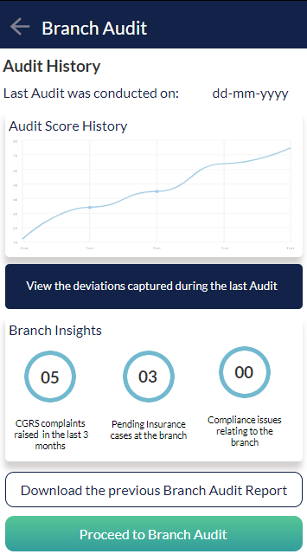
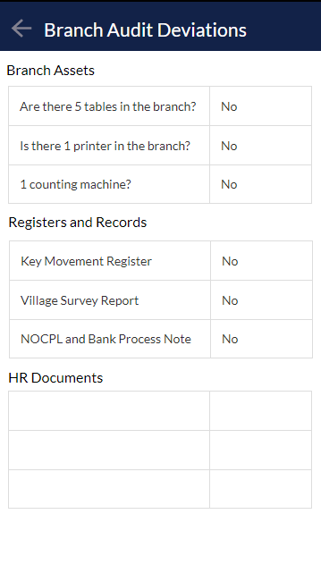
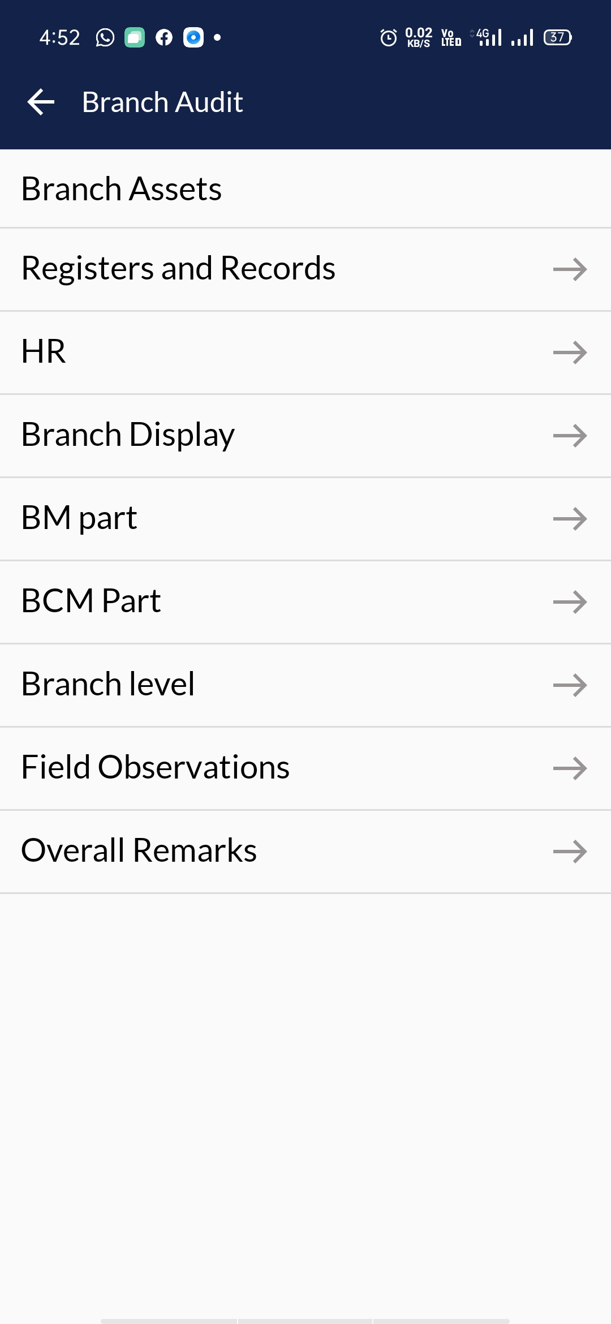
Branch Audit
Before proceeding with the branch audit,
Branch history and previous deviations are highlighted.

Slide 23
Reviewer Module

Slide 24
SCV

Slide 25
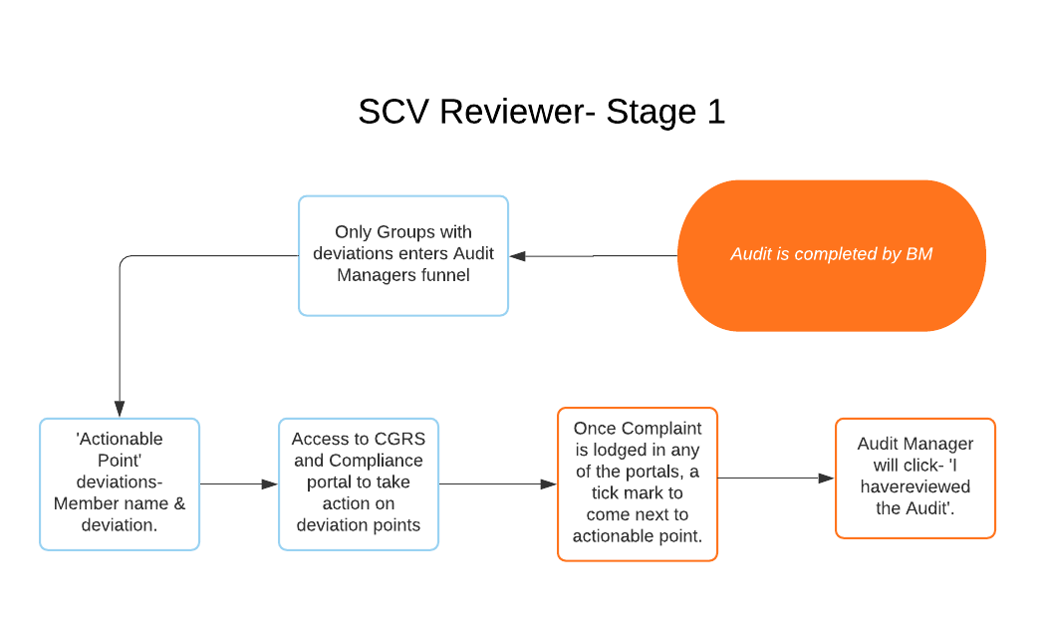
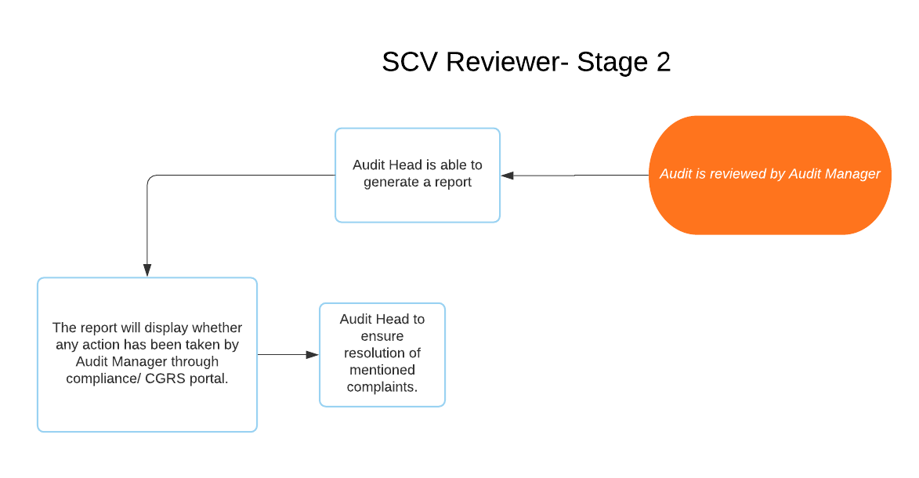
Stage 1:Reviewed by Audit Manager
(only actionable points)
Stage 2: Reviewed by Audit Head
Admin
Admin can see 1) Stage 1 review
2) Stage 2 review
3) Fully reviewed

Slide 26
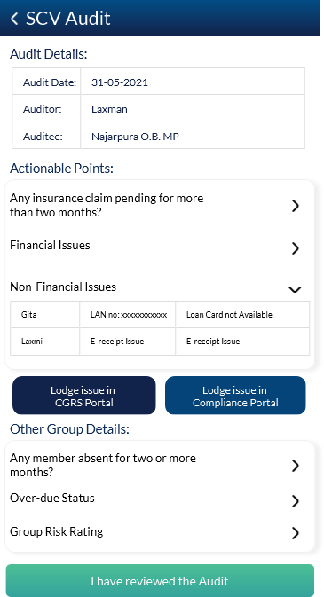

SCV- Audit Review-Stage 1- Audit Manager
Review
+ branch name
+ branch name
Review
Review
Audit Manager can see his current tasks-
Branch Audits to be completed and
SCV to be reviewed.
Audit Manager can file a complaint in the
CGRS and Compliance portal to clear actionable points.
When the complaint has been entered in the portal, a tick mark to come next to the claim.

Slide 27
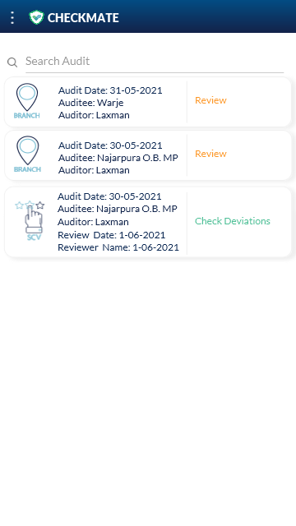
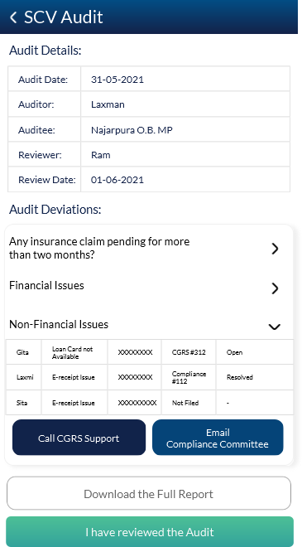
SCV- Audit Review-Stage 2- Audit Head
+ branch name
Audit Head can see his current tasks-
Branch Audits and
SCV to be reviewed.
Audit Head can view the deviations and download the full Audit Report.
He can also directly call CGRS helpline/ Mail compliance committee to know the status of the open issues.
Report Format in Excel Sheet

Slide 28
Branch Audit

Slide 29
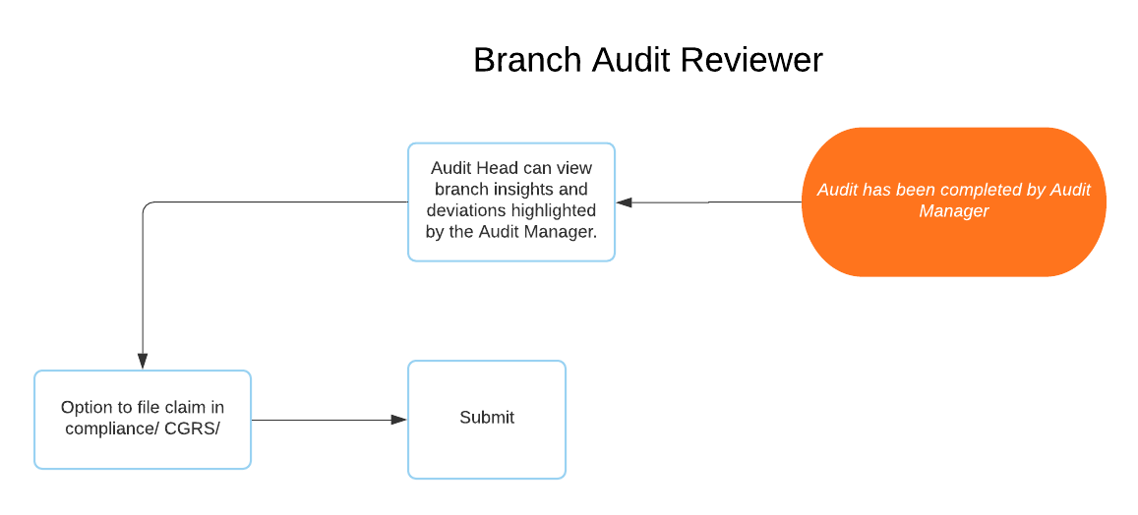
Reviewed by Audit Head

Slide 30
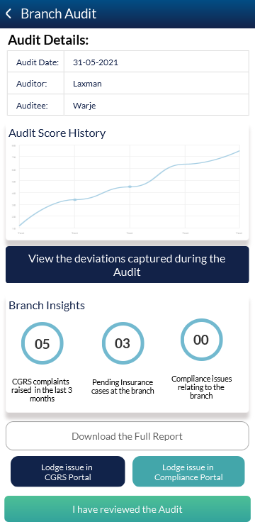
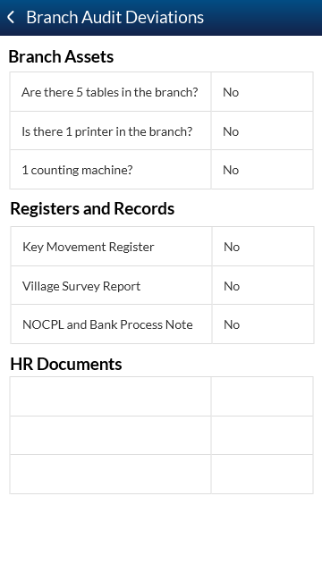
Branch Audit Review-Stage 1- Audit Head
Current Audit
Previous Audit
Audit Head can see his current tasks-
Branch Audits and SCV to be reviewed.
Audit Manager can view branch audit deviations, branch insights, download full report and lodge complaint in portals.
Branch Audit Deviation Screens.

Slide 31
Web Application- Audit Manager

Slide 32
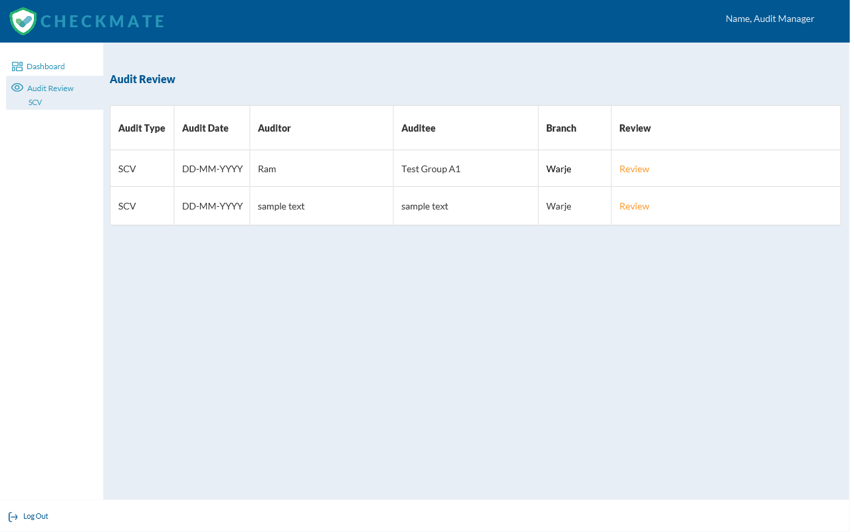
SCV Review- Audit Manager

Slide 33
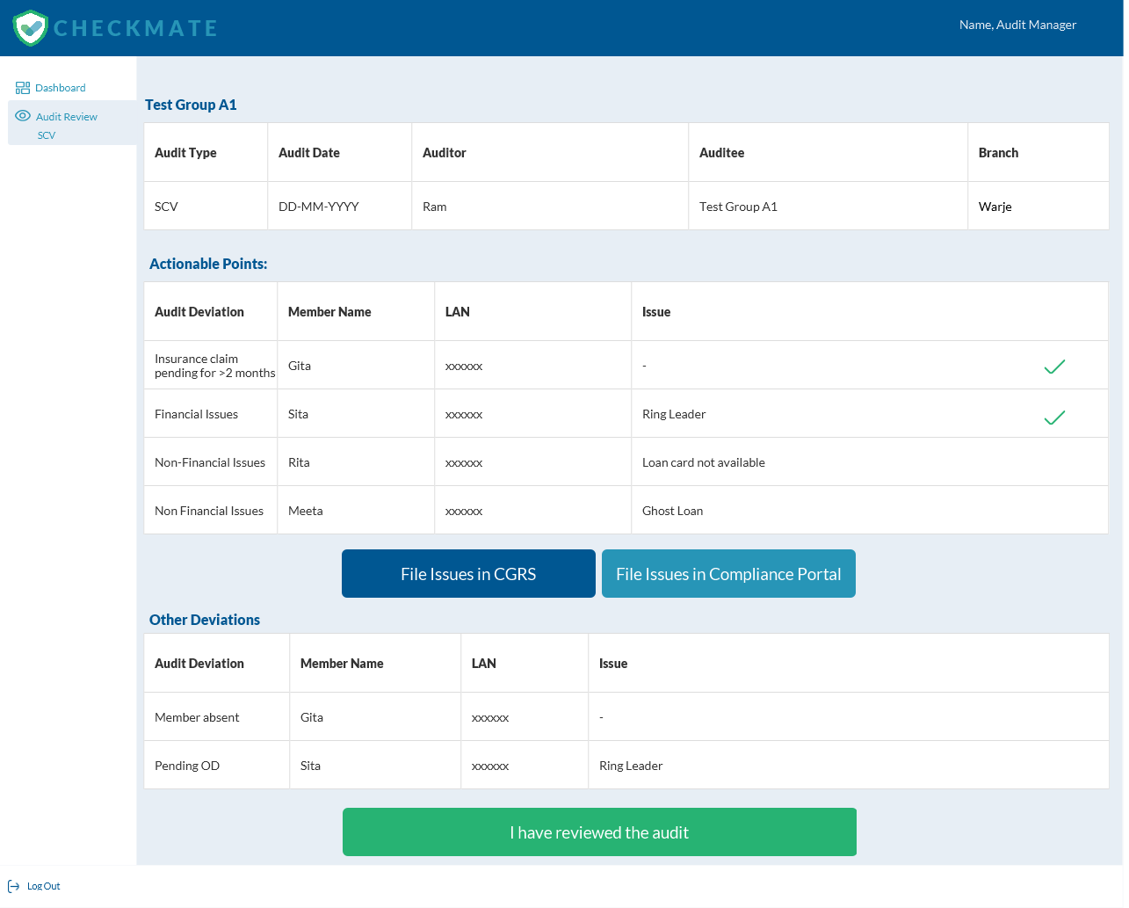
SCV Review- Audit Manager

Slide 34
Web Application- Audit Head

Slide 35
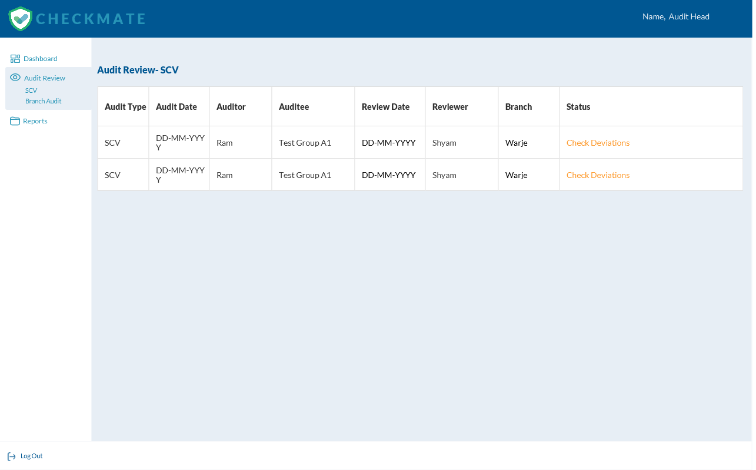
SCV Review- Audit Head

Slide 36
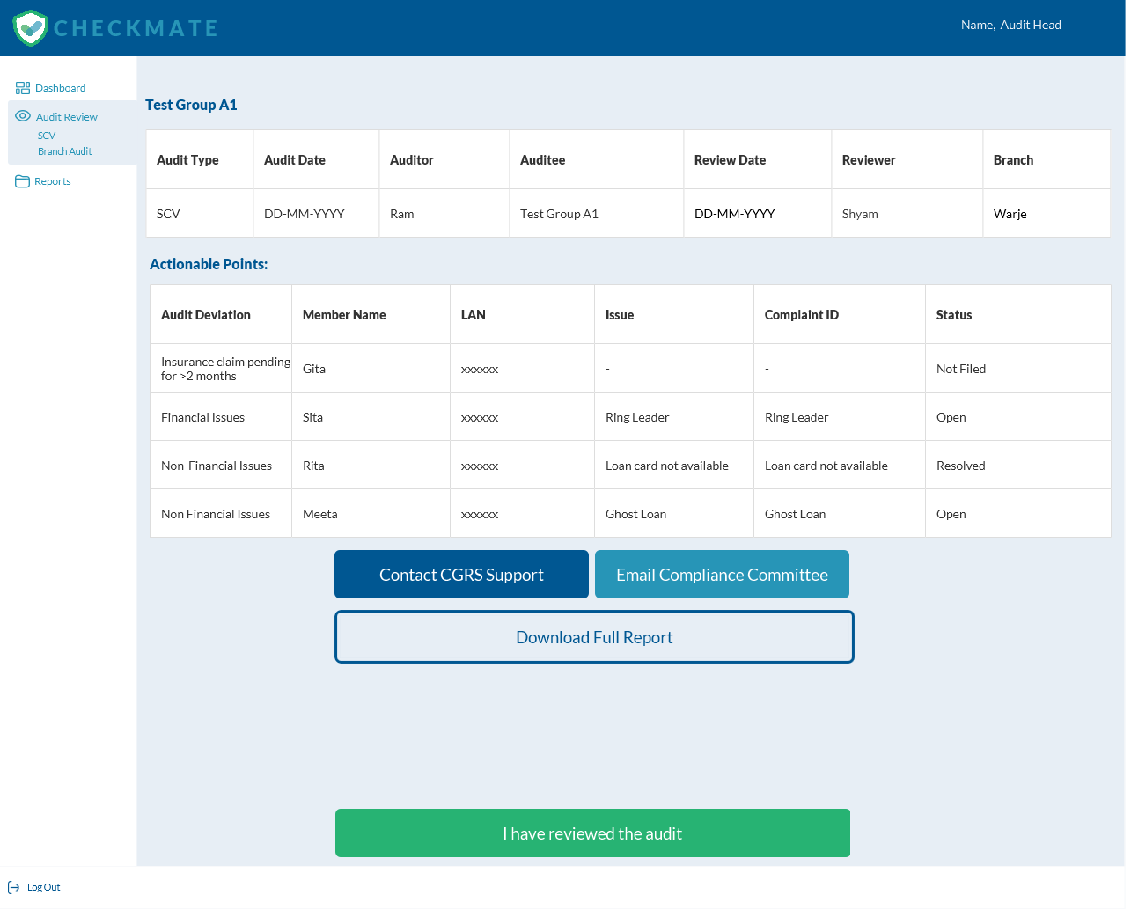
SCV Review- Audit Head

Slide 37
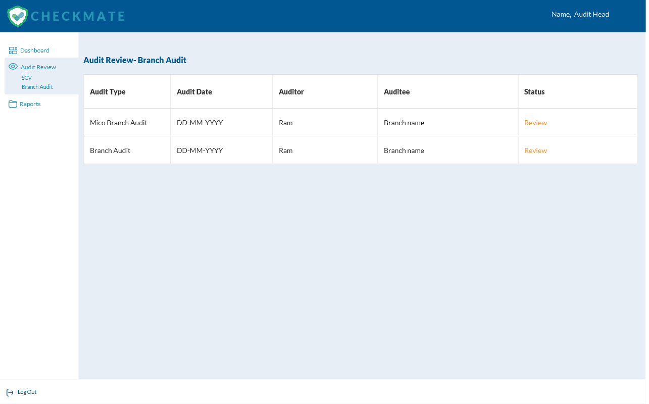
Branch Audit Review- Audit Head

Slide 38
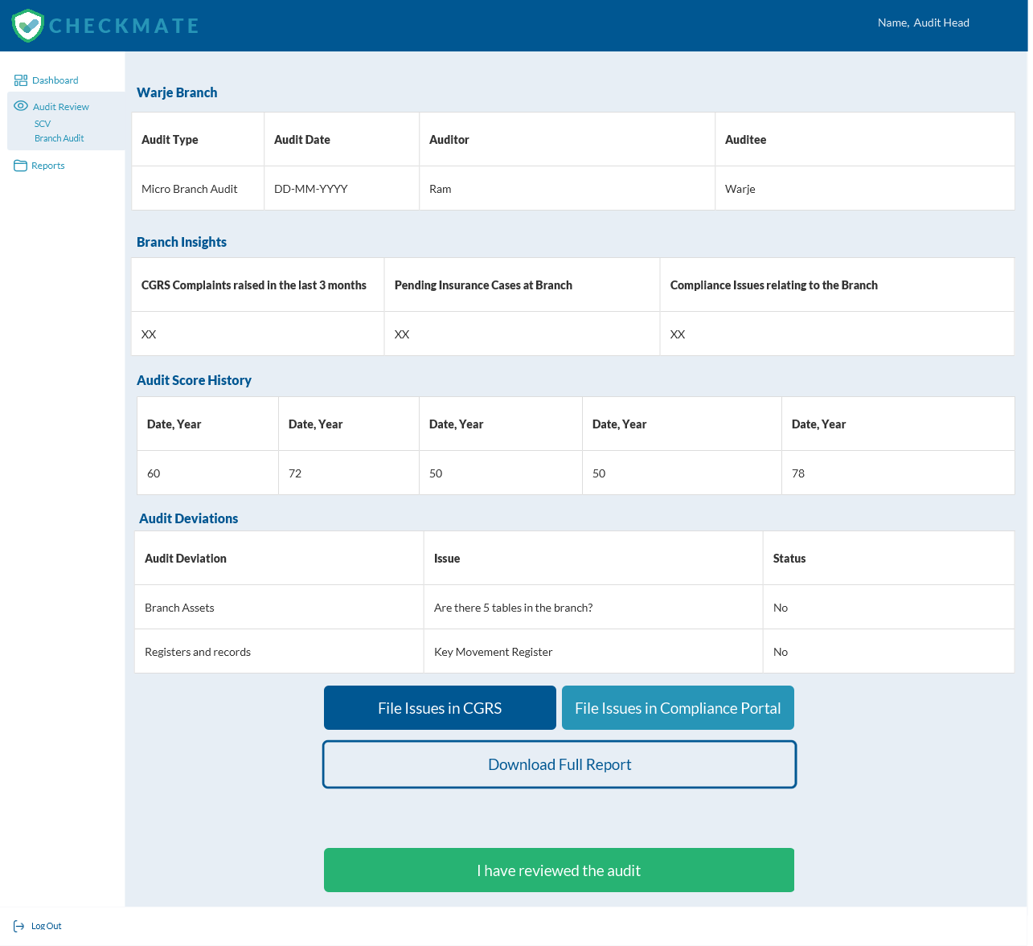
Branch Audit Review- Audit Head
Current Audit
Previous Audit

Slide 39
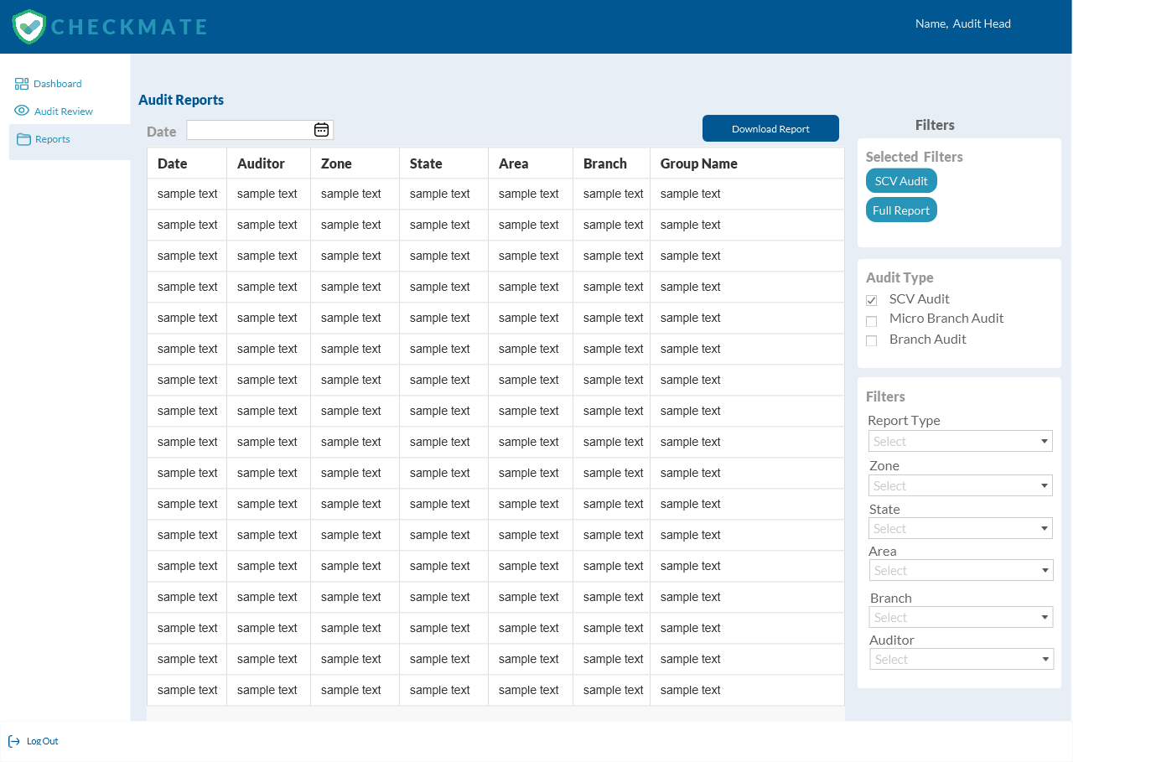
Reports Screen-Audit Head
Audit Head can view and download the following reports:
Branch Audit Report
Micro Branch Audit Report
SCV Report
Report type in case of SCV:
Deviation Report (only actionable deviations will be highlighted)
Full Report (all audit points will be reported)
Report type in case of Branch Audit
Deviation Report (only issues highlighted)
Full Report
Individual Branch Report

Slide 40
Web Application- Admin

Slide 41
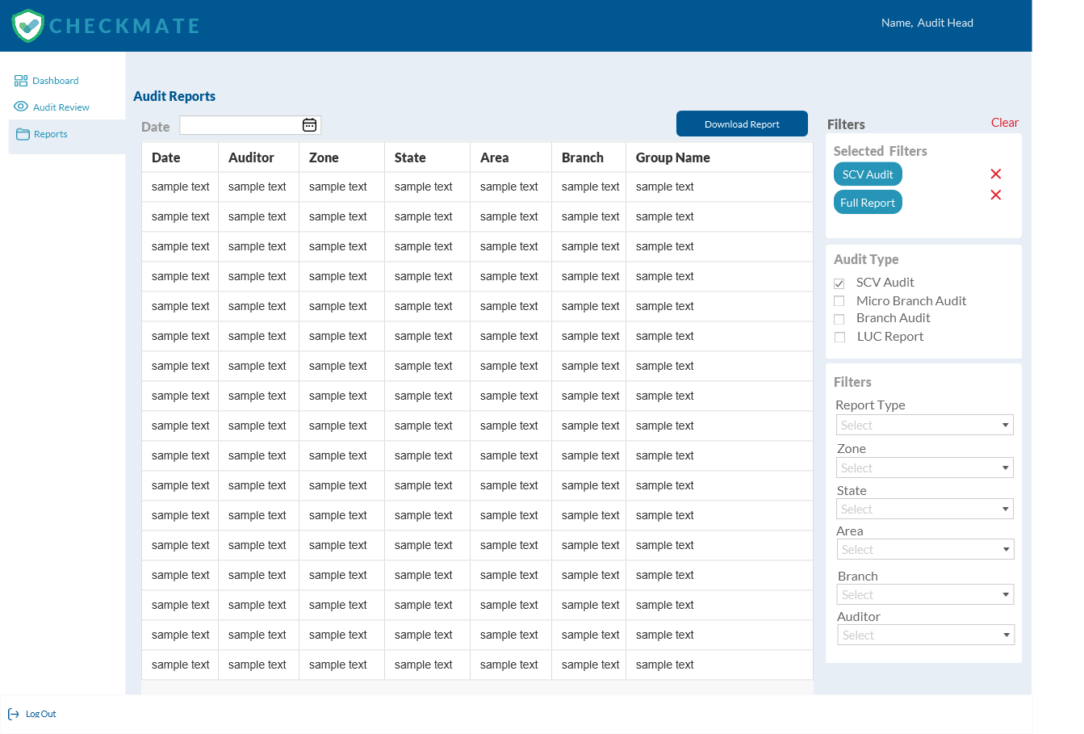
Reports Screen-Admin
Admin can view and download the following reports:
Branch Audit Report
Micro Branch Audit Report
SCV Report
LUC Report
Report type in case of SCV:
Deviation Report (only actionable deviations will be highlighted)
Full Report (all audit points will be reported)
Report type in case of Branch Audit
Deviation Report (only issues highlighted)
Full Report
Individual Branch Report
Report type in case of LUC Report:
Full Report

Slide 42
Dashboard Screens

Slide 43
Dashboard Screen-Audit Head
SCV Reviewed
00
SCV- Pending
00
Avg. Days taken for Review
00
Branch Audit Reviewed
00
Branch Audit- Pending
00
Avg. Days taken for Review
00
Complaints in CGRS
SCV- Deviation
Branch Audit- Lowest Score
SCV- High Risk
Lowest SCVs Performed
Highest Branch Audit Pending at AM’s end

Slide 44
Dashboard Screen-Admin-SCV
SCV Completed
05
SCV-In Process
03
Avg. Days taken for AM
06
Avg. Days taken for Audit Head
06
Complaints in CGRS
SCV- Deviation
Highest Review Pending at Audit Head’s end
Highest Review Pending at AMs end

Slide 45
Dashboard Screen-Admin-Branch
Branch Audits Completed
05
Branch Audits in Process
03
Avg. Audits performed by AM in a month
06
Avg. Days taken for AH to review Audit
06
Complaints in CGRS
Branch Audit- Lowest Score
Highest Branch Audit Pending at AM’s end
Branch Audit-Deviation Observations
Branch with highest complaints in CGRS Portal
Branches not visited in last 3 months

Slide 46
Open Complaints in CGRS
Complaint No. | Category | Branch | Date | Assigned to

