Slide 1
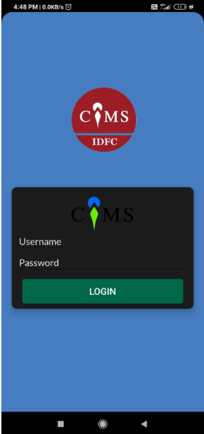
RO USER NAME & PASSWORD

Slide 2
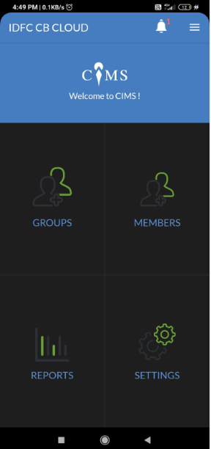
CLICK THE MARKED AREA

Slide 3
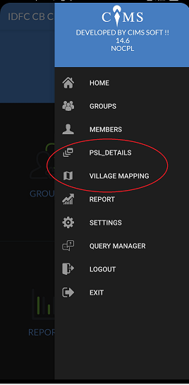
UPDATE PSL & VILLAGE DETAILS

Slide 4
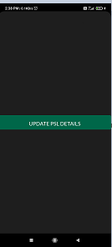
UPDATE THE PSL AND VILLAGE DETAILS WITHOUT MISMATCH

Slide 5
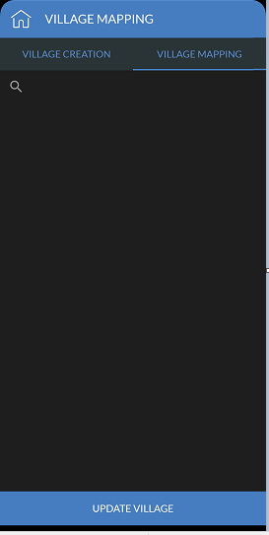
UPDATE VILLAGE

Slide 6
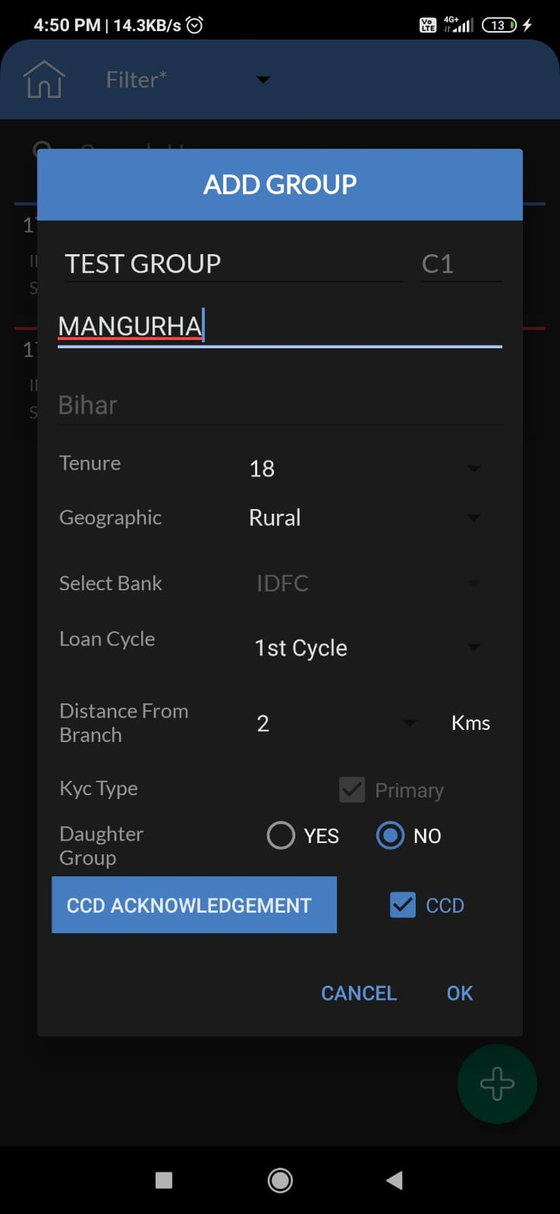
CREATE GROUP NAME & VILLAGE

Slide 7
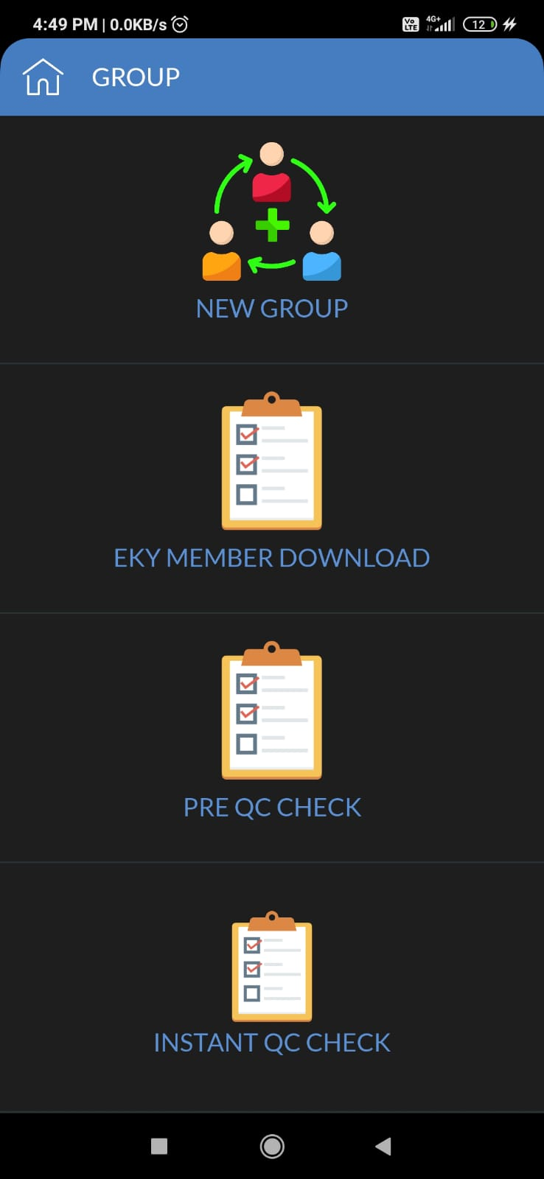
CLICK EKYC MEMBER DOWNLOAD

Slide 8
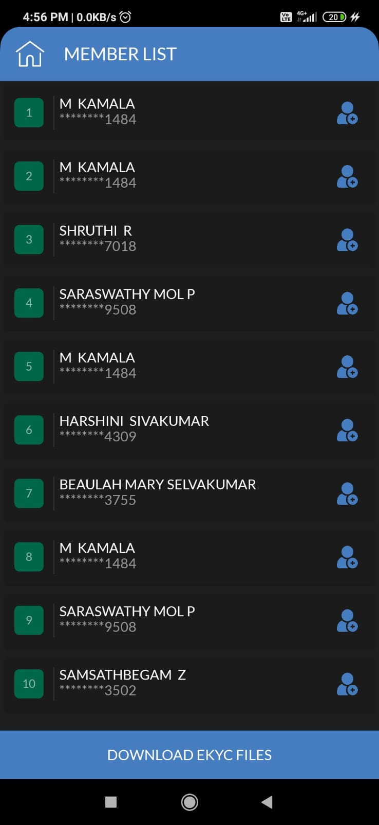
CLICK ON DOWNLOAD EKYC FILES
* WHILE DOWNLOADING THE MEMBER
SELECT THE GROUP TO WHICH THE MEMBER BELONGS.

Slide 9
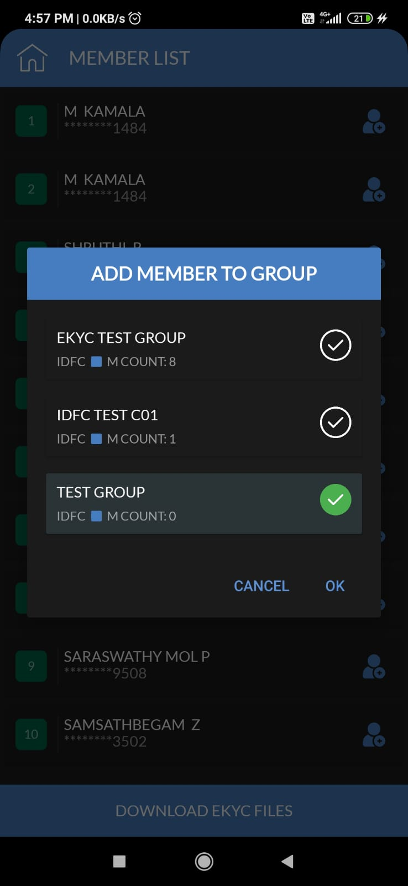
ADD MEMBER TO THE RESPECTIVE GROUP.
After selecting the required group click the tick button and its changed to green and click ok .

Slide 10
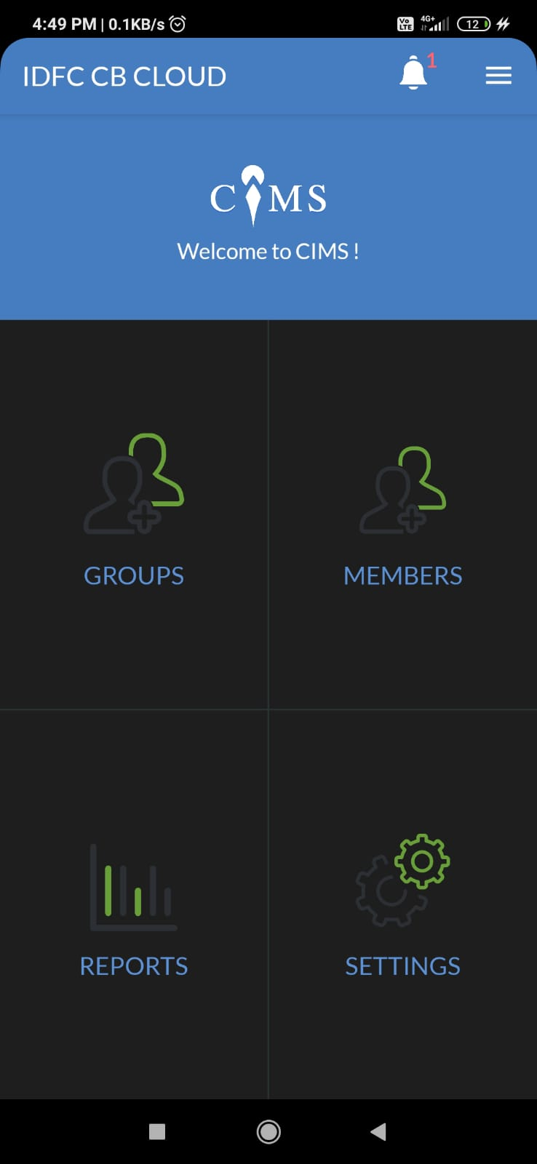
RO HOME SCREEN
RETURN TO HOMESCREEN

Slide 11
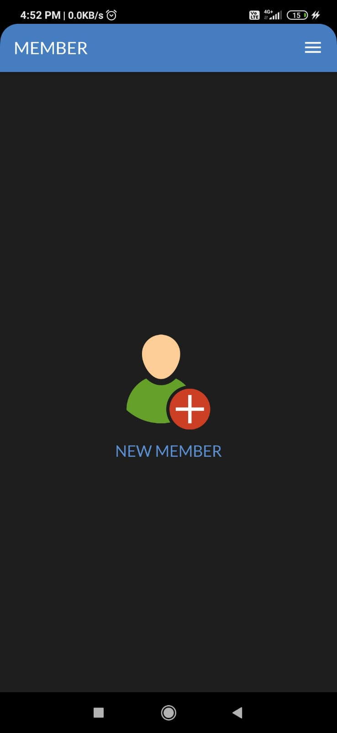
CLICK ON “ADD NEW MEMBER”

Slide 12
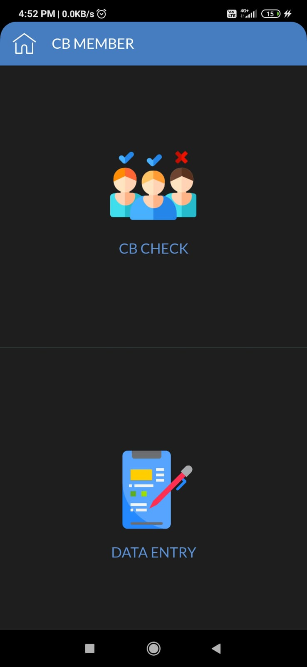
CLICK ON CB CHECK

Slide 13
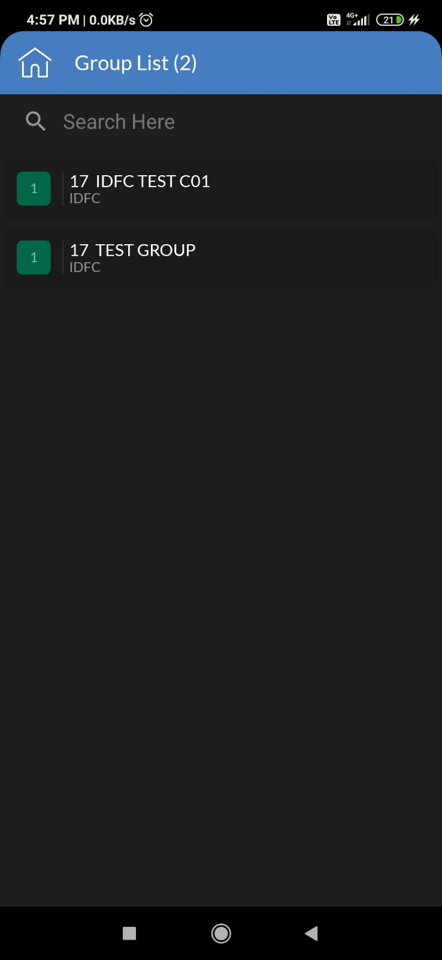
CLICK ONTO THE RESPECTIVE CENTER

Slide 14
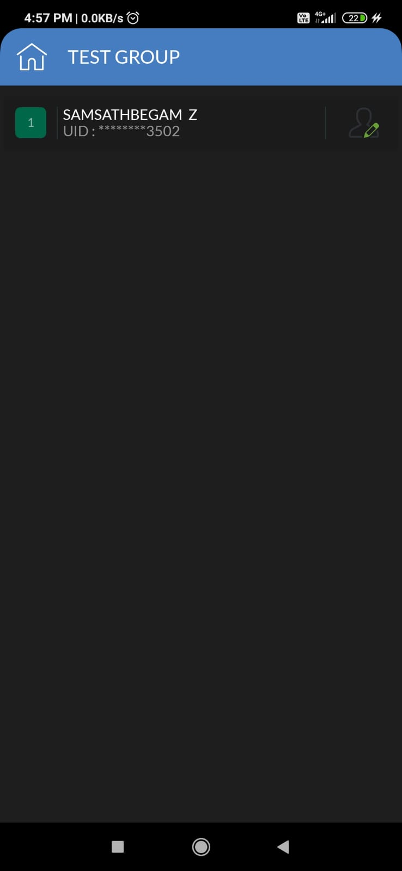
CLICK ON THE EDIT OPTION TO PROCEED CB CHECK

Slide 15
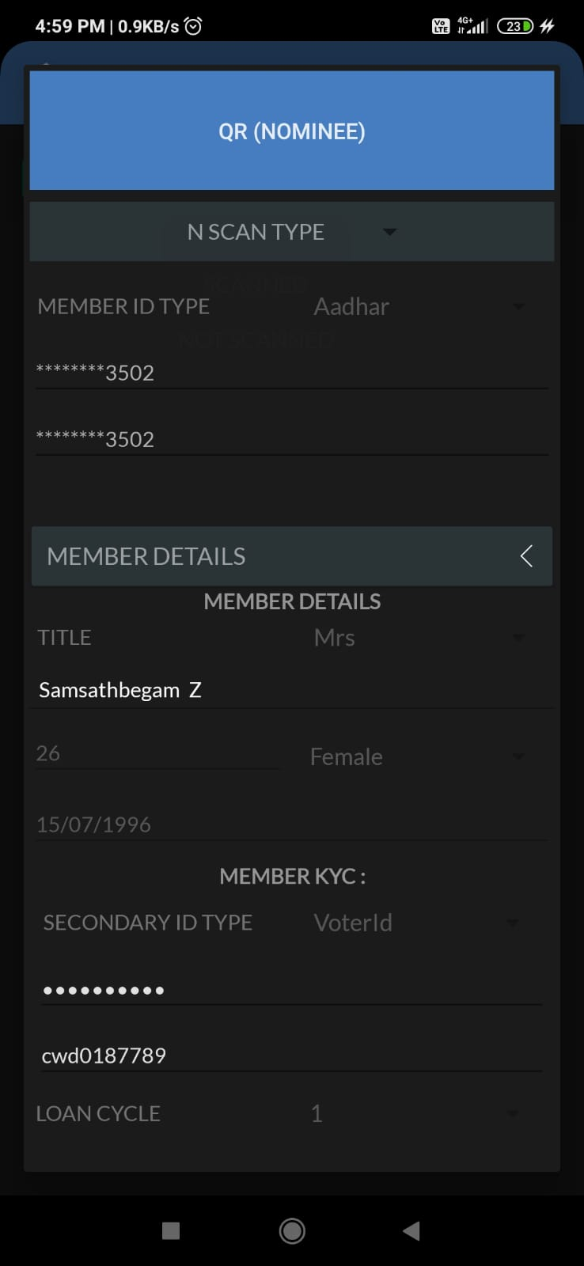
UPDATE MEMBER DETAILS AND MEMBER KYC

Slide 16
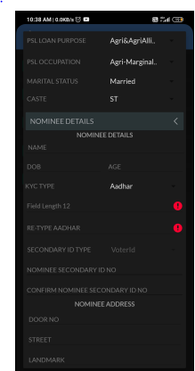
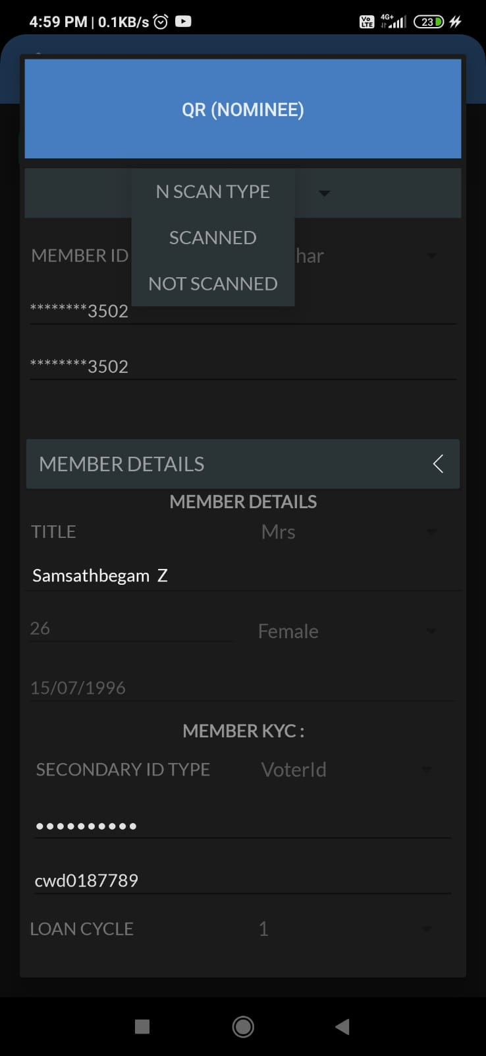
PLEASE SELECT SCAN TYPE
FOR NOMINEE PRIMARY KYC

Slide 17
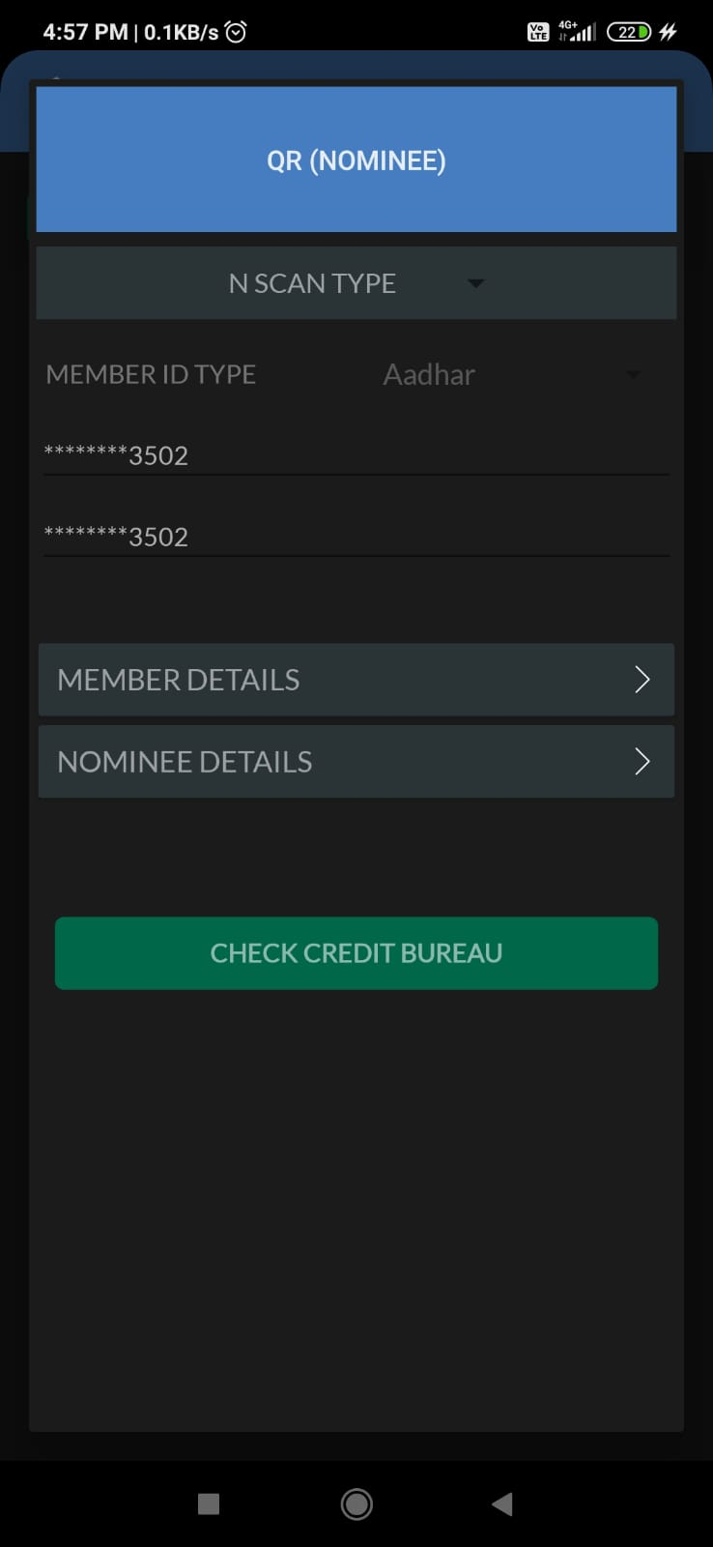
CLICK ON CHECK CREDIT BUREAU
Once done cb check

Slide 18
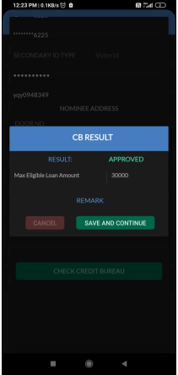
SAVE AND CONTINUE

Slide 19
START DETAILED DATA ENTRY

Slide 22
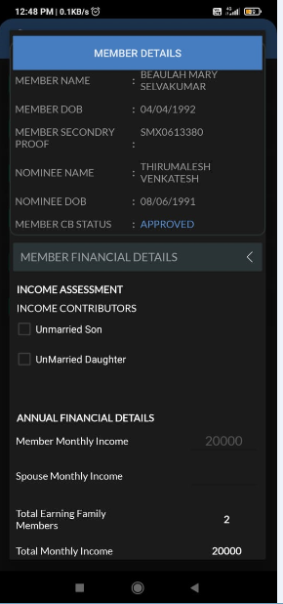
Income & Expenses details
# Annual Family Income shall be max upto 3.00 Lakhs/Year
*Family expense must be between 40% and 80% of Annual Income.
For Example : If member and spouse monthly income = 20000
and member and spouse annual income = 240000
Member family expense must be between 240000*40/100 = 96000
and 240000*80/100 = 192000
Debt Burden Ratio shall be max Between 1% to 49% ,but should not be “Zero”

Slide 23
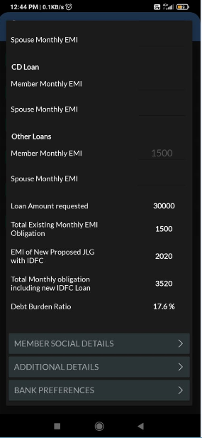

Slide 24
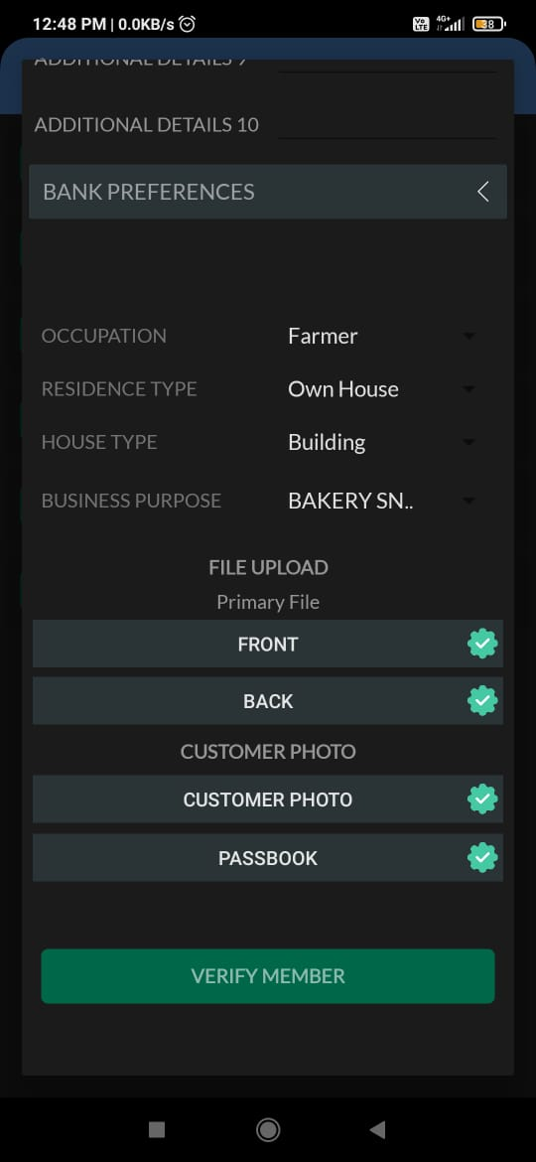

Slide 25
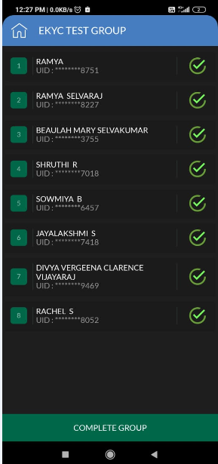
Once done click on complete group

